Slide 1
Face Recognition Algorithm Based on VGG Network Model and SVM
Đào Việt Duy – MSSV: 51603070
Nguyễn Duy Hàn Lâm – MSHV: 196005004

Slide 2
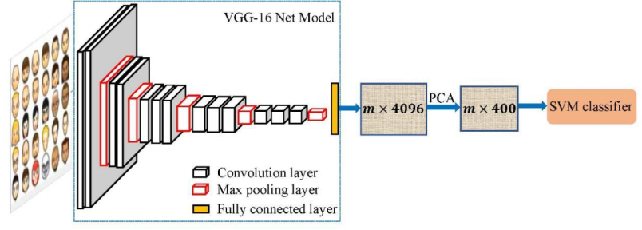
Concept
Nguồn: Hongling Chen, Chen Haoyu, 2019, Face Recognition Algorithm Based on VGG Network Model and SVM.

Slide 3
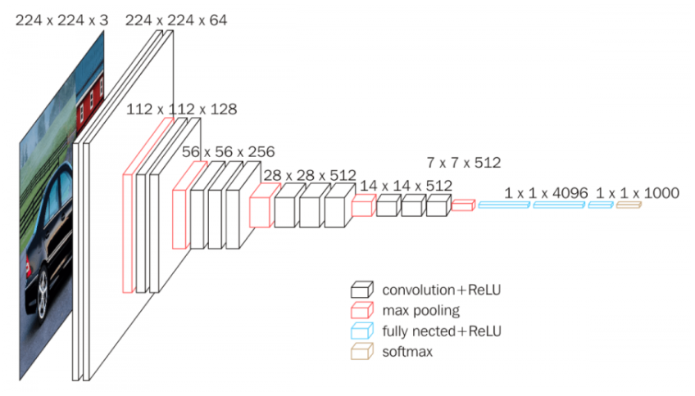
VGG model concept
Nguồn: https://neurohive.io/en/popular-networks/vgg16/

Slide 4
VGG CNN stack
28x28x512
224x224x64
112x112x128
56x56x256
14x14x512

Slide 5
VGG Max-pooling stack
28x28x512
14x14x512
112x112x128
56x56x256
7x7x512

Slide 6
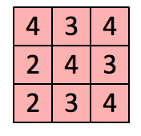
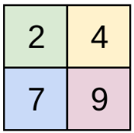

VGG CNN window size
3x3
1x1
2x2
CNN Layer
Max-pooling Layer

Slide 7
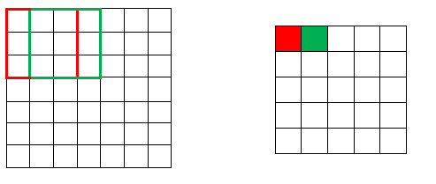
VGG CNN window stride
Window stride = 1

Slide 8
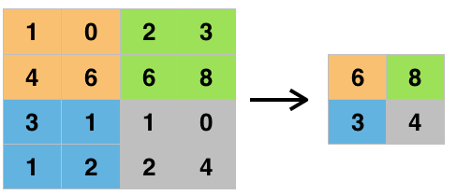
VGG Max-pooling window stride
Window stride = 2

Slide 9
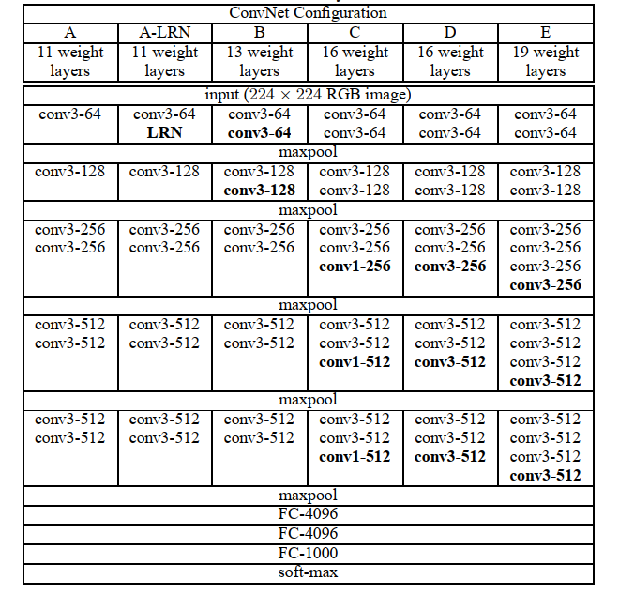
VGG types
Nguồn: Karen Simonyan, Andrew Zisserman, 2015, Very Deep Convolutional Networks For Large-Scale Image Recognition.

Slide 10
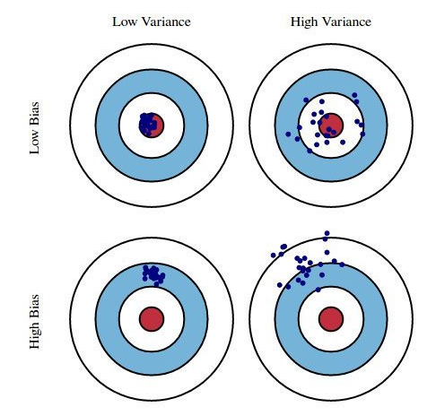
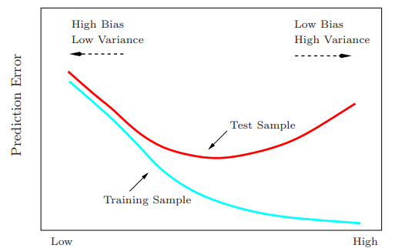
Bias và Variance
Nguồn: Trevor Hastie, Robert Tibshirani, Jerome Friedman, 2008, The Elements of Statistical Learning: Data Mining, Inference, and Prediction (Second Edition).

Slide 11

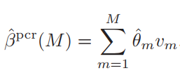
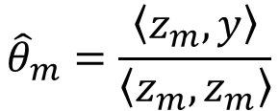
Principle Component Regression
Phân tập dữ liệu thành tập các thành phần z
$${\hat{θ}}_{m}=\frac{\left\langle z_{m},y\right\rangle }{\left\langle z_{m},z_{m}\right\rangle }$$
Chọn tập có m z_component có sai số nhỏ nhất làm mô hình chính.

Slide 12
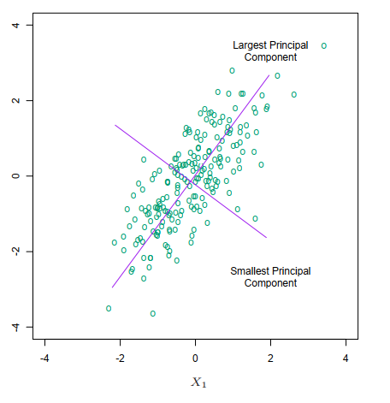
Principle Component Regression
Nguồn: Trevor Hastie, Robert Tibshirani, Jerome Friedman, 2008, The Elements of Statistical Learning: Data Mining, Inference, and Prediction (Second Edition).

Slide 13
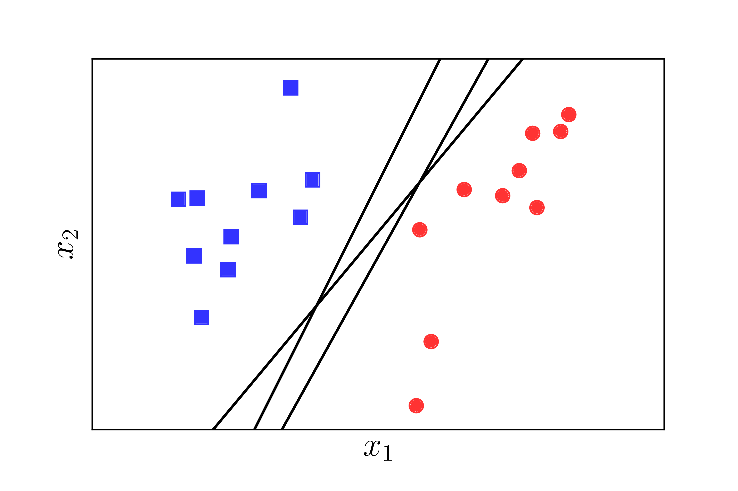
Support Vector Machine

Slide 14
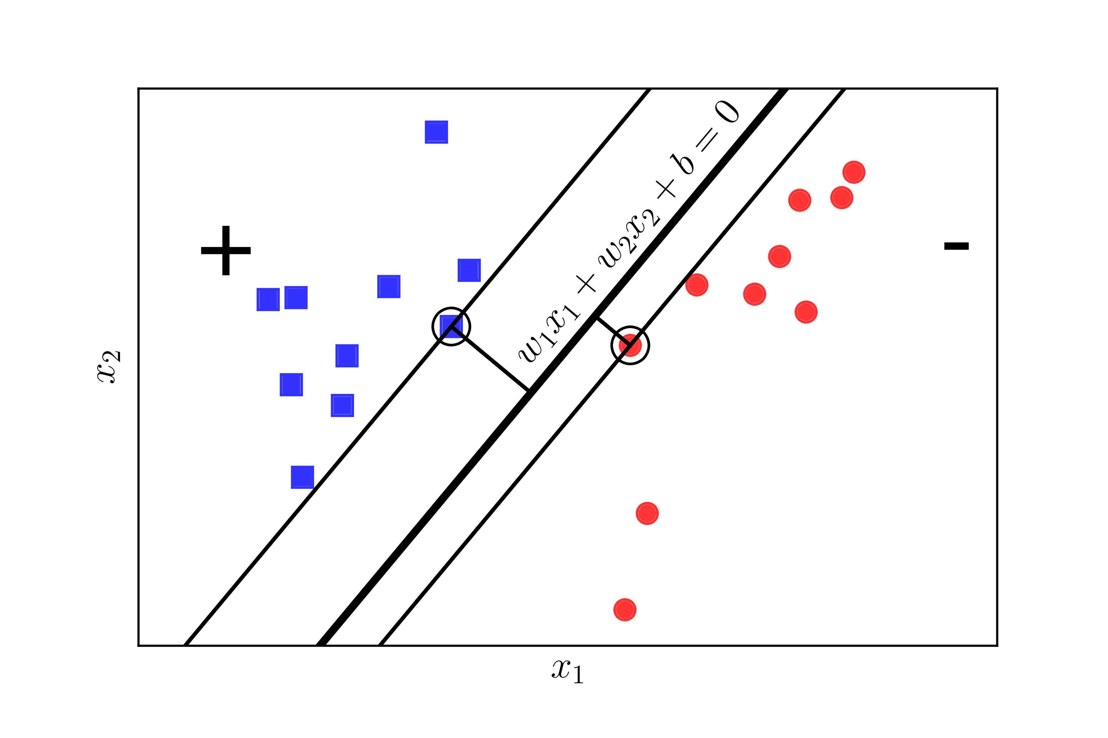
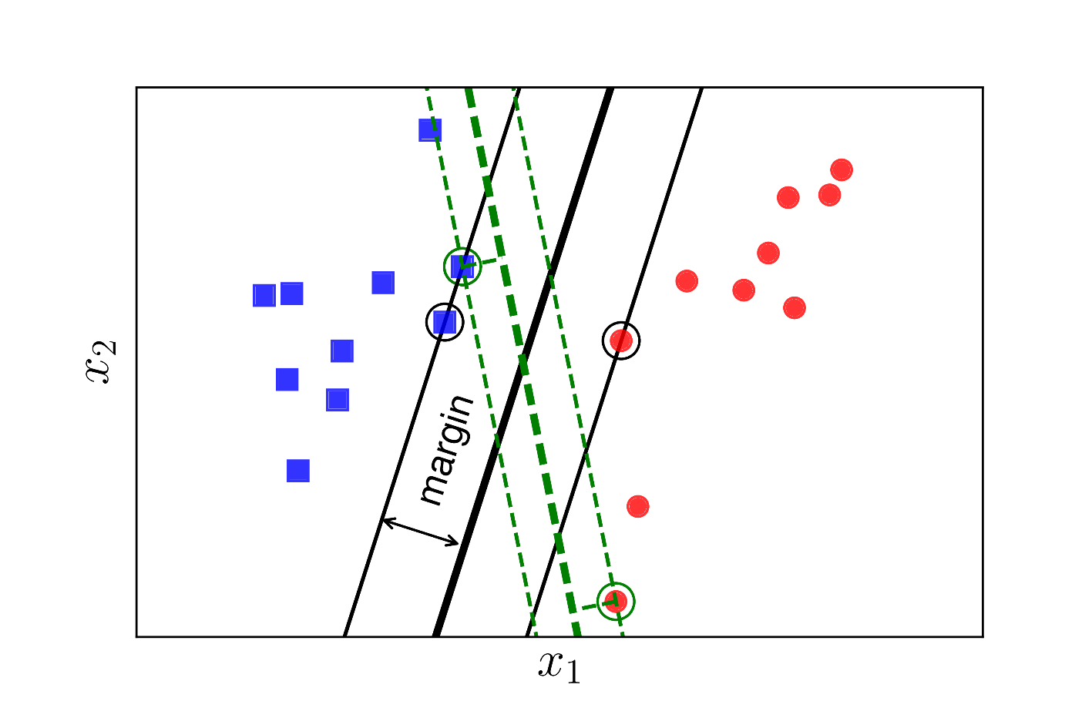
Support Vector Machine

Slide 15
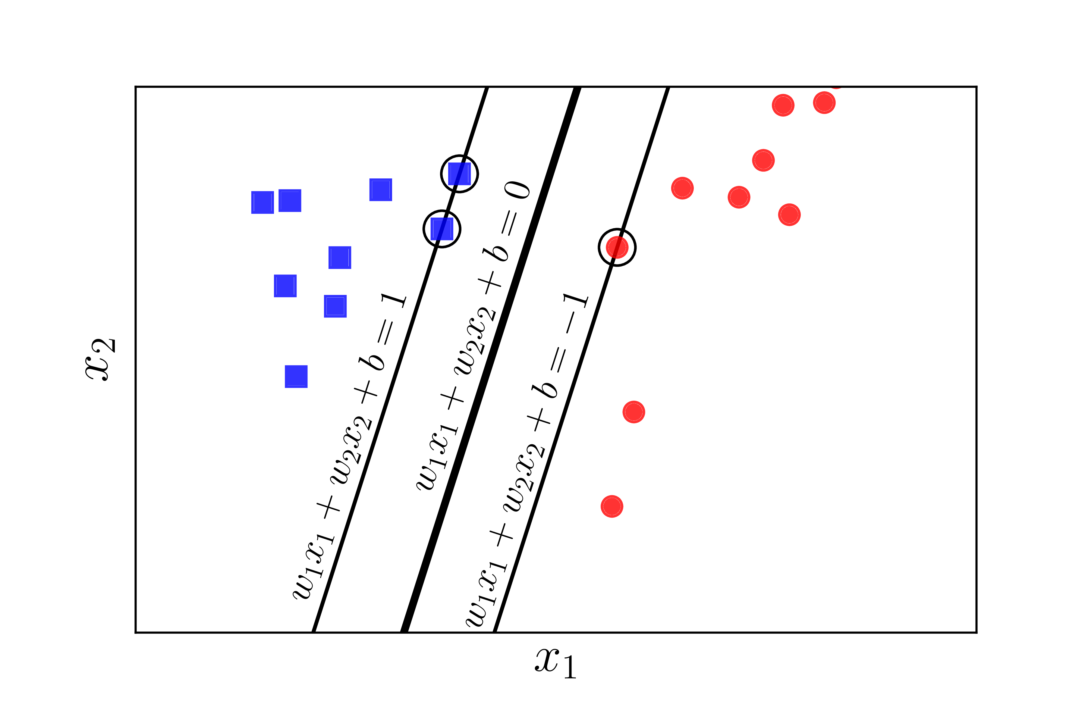
Support Vector Machine

Slide 16
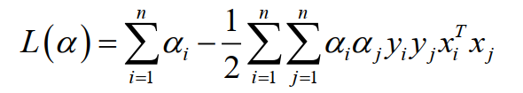

Support Vector Machine
Linear separable

Slide 17


Support Vector Machine
Non-linear separable

Slide 18
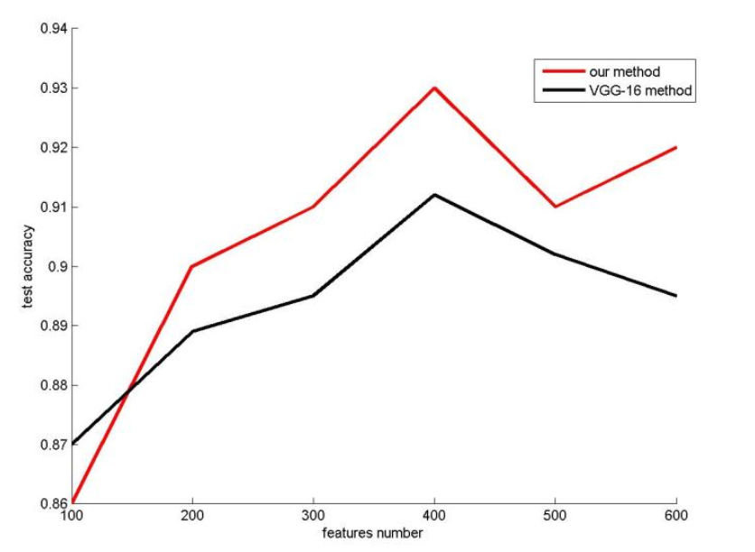
Paper result
Nguồn: Hongling Chen, Chen Haoyu, 2019, Face Recognition Algorithm Based on VGG Network Model and SVM.

Slide 19
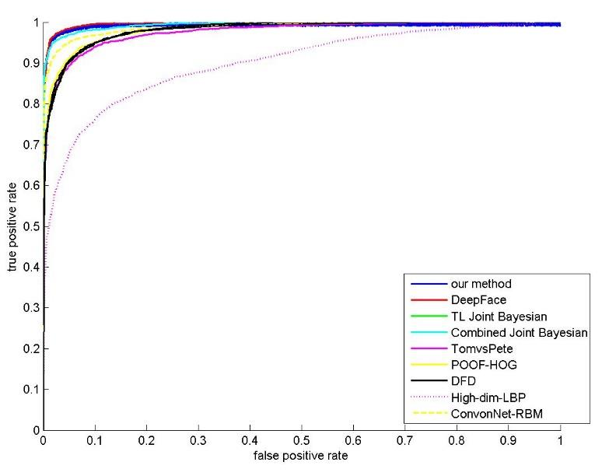
Paper result
Nguồn: Hongling Chen, Chen Haoyu, 2019, Face Recognition Algorithm Based on VGG Network Model and SVM.

Slide 20
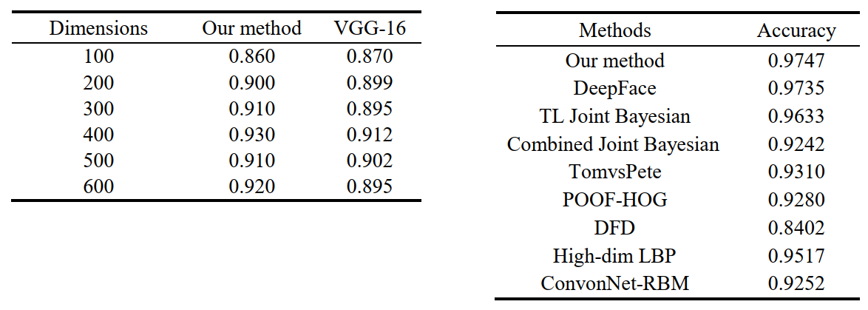
Paper result
Nguồn: Hongling Chen, Chen Haoyu, 2019, Face Recognition Algorithm Based on VGG Network Model and SVM.

